Slide 1
The Rational Use of Antibiotics and prescription writing
Presenters: C2 Bethelhem Tesfaye
Bithanya Sirak
Eden Girma
Etsegenet Assefa
Moderator:Dr.Achalu(Assistant professor of pediatric and child health)

Slide 2
INTRODUCTION
Antibiotic: a substances produced by microorganisms that selectively inhibit the growth of or kill other microorganisms at very low concentration.
Antimicrobial: a broader term for any agent that kills or inhibits microorganisms ( bacteria, viruses, fungi and parasites).

Slide 3
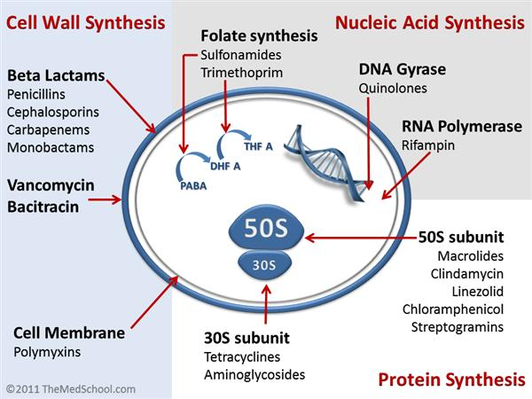
Basic Pharmacology
Pharmacokinetic: describes what the body does to the drug.
Pharmacodynamics : describes what the drug does to the bacteria.

Slide 4
Classificaton of drugs
Based on effect on the bacteria:
Bactericidial.
Bacteriostatic.
Based on pharmacodynamic activity:
Time dependent.
Concentration dependent.
Exposure dependent.

Slide 5
Principles of Antibacterial Therapy
Antibacterial therapy is the appropriate use of antibiotics to prevent or treat bacterial infections while maximizing clinical cure and minimizing toxicity, resistance , unnecessary costs
Empiric therapy.
Definitive (Targeted) therapy.
Prophylactic therapy.

Slide 6
1. Empiric Therapy
Therapy is considered empirical when the causative agent has yet to be determined and therapeutic decisions are based on
The severity of illness,
The likely pathogens and
Prior therapy, and
Relevant epidemiologic factors.

Slide 7
When is Empiric Therapy Used?
Life-threatening infections (e.g., sepsis, meningitis, pneumonia, complicated UTI).
Severe clinical deterioration.
When diagnosis is likely based on history, physical exam, and epidemiology.

Slide 8
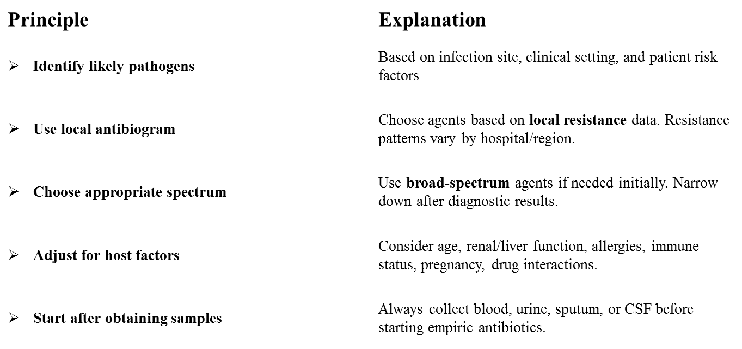
Key principles of empiric therapy

Slide 9
Indication for Antibiotic use
Proven bacterial infection.
Strongly suspected bacterial infection (empiric therapy).
Surgical prophylaxis.
Medical prophylaxis ( selected high risk patients ).
Factors Affecting Antibiotics Choice
Patient factor.
Infection factor.
Drug factors.

Slide 10
2. Definitive therapy
Is antibiotic therapy adjusted after the causative organism and its susceptibility are identified by culture.
Usually after 48-72 hrs after culture are obtained.
Principles include
Review culture results.
Identify the pathogen.
Select the narrowest effective antibiotic.
Adjust dose if needed.
De-escalate from broad –spectrum therapy whenever appropriate.
Continue treatment for the recommended duration.

Slide 11
3. Prophylactic Therapy
Is the administration of antibiotics to prevent infection in patients at increased risk.
Surgical prophylaxis : to prevent surgical site infection.
Give the antibiotic with in 60 minute before the surgical incision and 120 minutes for antibiotics requiring longer infusion.
B. Medical prophylaxis
used in selected high risk patients e.g Rheumatic fever prophylaxis ( benzathine penicillin), meningococcal exposure ( rifampicin, ciprofloxacin, or ceftriaxone) , endocarditis prophylaxis.

Slide 12
Culture and Sensitivity Testing
Definition
Culture: a laboratory process of growing microorganisms from a clinical specimen to identify the causative pathogen.
Sensitivity (susceptibility): laboratory testing that determines which antibiotics are effective against the isolated organism.

Slide 13
Purpose
Identify the causative pathogen.
Guide appropriate antibiotic selection.
Enable de-escalation from broad to narrow spectrum antibiotics.
Reduce unnecessary broad-spectrum antibiotic use.
Prevent antimicrobial resistance.
Reduce costs.
Improve patient outcome.

Slide 14
Interpretation
After the organism is identified, the laboratory reports its susceptibility to different antibiotics.
The report classifies antibiotics as
S- Susceptible: the organism is likely to respond to antibiotic at standard doses.
I- Intermediate: antibiotic may work if higher doses or optimized doses are used.
R-Resistant :the antibiotic is unlikely to be effective and should not be used.

Slide 15
Minimum Inhibitory Concentration (MIC)
The lowest concentration of an antibiotic that inhibits visible bacterial growth.
Helps determine how susceptible a bacterium is to an antibiotic.
Lower MIC values generally indicates greater susceptibility.

Slide 16
Antibiotic resistance
Antimicrobial resistance is the ability of microorganisms to survive and/or multiply in the presence of tolerable doses of antimicrobial medicines.
Antimicrobial resistance can be:
Natural.
Acquired.

Slide 17
Mechanisms for antimicrobial resistance
Alteration of drug-binding sites.
Production of enzymes inactivate drug.
Synthesis of compound antagonize drug actions.
Efflux pumps.
Decreased permeability of bacterial cell wall.

Slide 18
Types of antimicrobial resistance
There are different types of antimicrobial resistance.
These include:
Multi Medicine Resistance (MDR) (resistance to two or more medicines).
Cross-resistance, (resistance that occurs among two different antimicrobials).
Co-resistance, (more than one mechanism of resistance is involved by the same organism for a given antimicrobial).

Slide 19
The Rational use of antibiotics
According to WHO:-
"Patients receive medications appropriate to their clinical needs, in doses that meet their own individual requirements, for an adequate period of time, and at the lowest cost to them and their community.

Slide 20
Principles of Rational Antibiotics use
Use antibiotics only for suspected or proven bacterial infections.
Obtain appropriate specimens for culture before starting antibiotics when ever possible.
Begin empiric therapy based on the likely pathogen, age, site of infection, and local resistance pattern.
Modify (de-escalate)treatment once culture and susceptibility results are available.

Slide 21
…
Choose the narrowest-spectrum antibiotic that effectively treats the infection.
Use the correct dose, route , and duration.
Monitor clinical response and adverse effects.
Avoid unnecessary antibiotic use to reduce antimicrobial resistance.

Slide 22
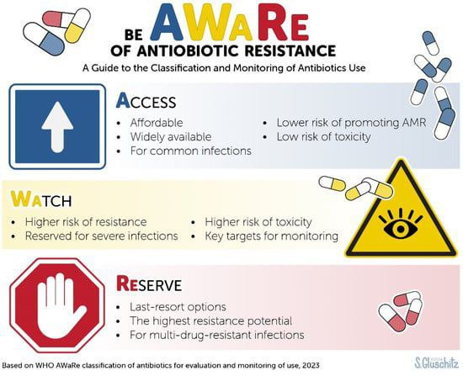
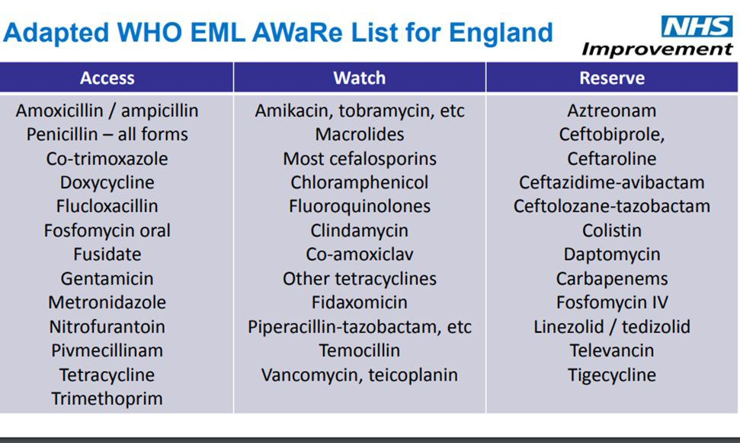

Slide 23
Stewardship program
Is an organized antimicrobial management program that can be undertaken to improve antimicrobial usage.
Goal of antibiotic stewardship programs
Reduce antibiotics consumption and inappropriate use.
Improve patient outcomes and decrease morbidity and mortality.
Increase adherence/utiliztion of teatment guidlines.
Reduce adverse drug events.
Decrease or limit antibiotic resistance.
Reduce healthcare cost.

Slide 24
5D’S of antibiotic stewardship
Right DRUG.
Correct DOSE.
Right DRUG ROUTE.
Suitable DURATION.
Timely DE-ESCALATION.

Slide 25
De-scalation
Antimicrobial de-escalation is a primary antimicrobial tool to prevent the emergence of drug-resistant bacteria.
The term de-escalation describe the practice of using culture results as a basis for switching from broad-spectrum to more narrow spectrum.
It may also include changing administration from the IV to PO, or discontinuing antimicrobials if infection has been ruled out.
Key Takeaway: Antimicrobial de-escalation is appropriate to consider in any clinically improving patient after 2-4 days of empiric therapy.

Slide 26
Management of sepsis.
Non pharmacologic
Maintenance of body temperature (Kangaroo mother care, radiant warmer, incubator).
Adequate calorie and fluid maintenance.
Correction of associated metabolic abnormalities.

Slide 27
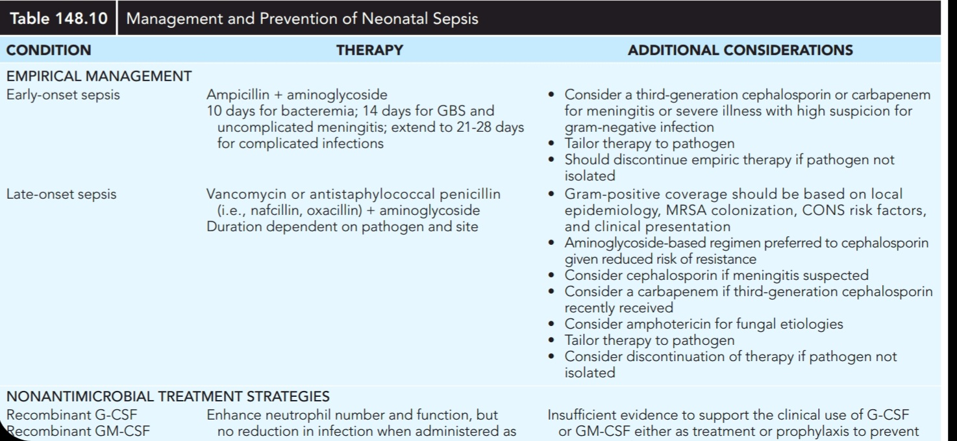

Slide 28
Pharmacologic
Till the culture report is collected start with broad-spectrum antibiotics, which includes
Penicillin and Aminoglycoside.
First line
Ampicillin, 100mg /kg/day every 12 hours IV.for 10 days.
PLUS
Gentamicin, 5mg/kg /day IV Daily for 10 days
Alternative
Penicillin G Sodium Crystalline, 50,000IU/kg QID for ten days
PLUS
Gentamicin, 5mg/kg /day IM Daily for 10 days.

Slide 29
Management of acute otitis media.
Non Pharmacologic
Drink lots of fluid.
Paracentesis when indicated.
Pharmacologic
First line: Amoxicillin
Children under 6 years; 125mg/5ml, 250mg/5ml 1 tsp. P.O., TID for ten days
Children above 6 years; 250 mg P.O., TID for ten days.
Alternatives
Ampicillin, 100-200mg/kg IV into divided doses QID for children for 10 days.

Slide 30
Amoxicillin/Clavulanate, 312mg/5ml suspension P.O. TID for 10 days OR 156mg/5ml suspension P.O. TID for 10 days for children.
Ciprofloxacin, 500mg P.O., BID FOR 7-10 days.
Ciprofloxacin ear drop eye ear solution, 0.3%, 5ml. 2 – 3 drops twice daily.
Chloramphenicol, Solution ear drop, 1%, 2%, 5%. Apply 2–3 drops 2–3times daily.
Paracetamol, 30-40mg/kg/24hrs.

Slide 31
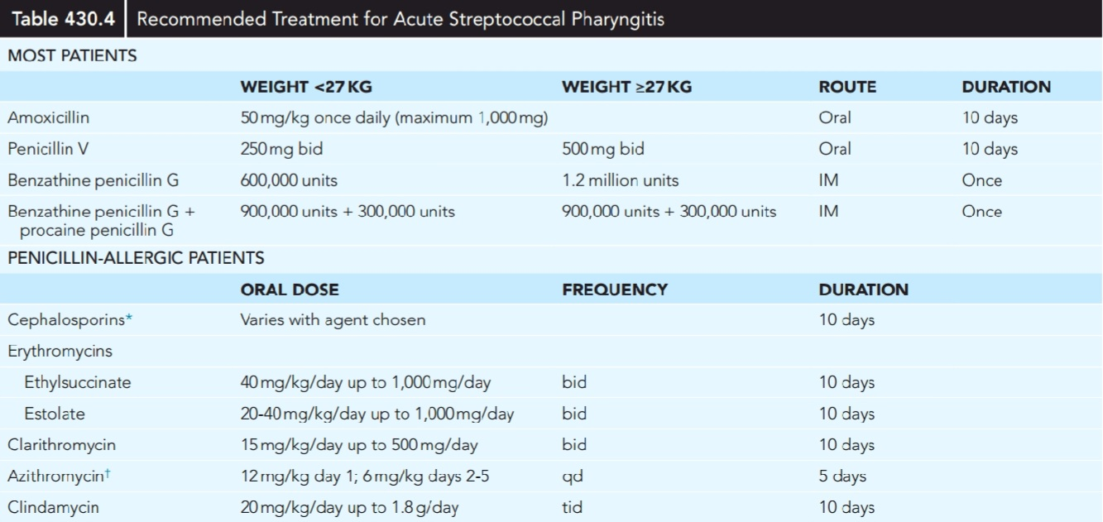
Management of acute pharyngitis

Slide 32
Management of pneumonia
Pharmacologic
1. Antipyretic
First line
Paracetamol, 10-15mg /kg P.O., up to 4 times a day for the relief of high fever equal to or above 39 ºC.
Alternatives
Ibuprofen, 5 – 10mg/kg/dose every 6 – 8hr P.O. (max. 40mg/kg/24hours).
2. Antibiotic
First-line
Amoxicillin, 30-50mg/kg/24hourss P.O. TID for 7 days.
Alternatives
Azithromycin, 10mg/kg/24 P.O., once daily for 3 days.

Slide 33
Severe Pneumonia
Benzyl penicillin, 50,000units/kg/24hours IM OR IV QID for at least 3 days.
N.B. When the child improves switch to oral Amoxicillin: 30-50mg/kg/24 hours 3 times a day. The total course of treatment is 10 days.
If the child doesn’t improve within 48 hours, switch to ceftriaxone 50mg/Kg/24 hours IM/IV for 5 days.
Presumed Atypical pneumonia
Azithromycin, 10mg/kg P.O., on day 1, 5mg/kg on day 2-5.

Slide 34
Management of UTI
Supportive care
The child should be encouraged to drink or breastfeed regularly in order to maintain a good fluid intake, which will assist in clearing the infection and prevent dehydration.
If the child has pain, treat with paracetamol; avoid non-steroidal anti-inflammatory drugs (NSAIDs).

Slide 35
Pharmacologic
Treat the child as an outpatient.
Give an oral antibiotic for 7–10 days, except:
When there is high fever and systemic upset (such as vomiting or inability to drink or breastfeed).
When there are signs of pyelonephritis (loin pain or tenderness).
For infants.

Slide 36
Give oral co-trimoxazole (10 mg/kg trimethoprim and 40 mg/kg sulfamethoxazole every 12 h) for 5 days.
If there is a poor response to the first-line antibiotic, give gentamicin (7.5 mg/kg IM or IV once daily) plus ampicillin (50 mg/kg IM or IV every 6 h) or parenteral cephalosporin.
Consider complications such as pyelonephritis or septicaemia.
Treat young infants aged < 2 months with gentamicin at 7.5 mg/kg IM or IV once daily until the fever has subsided; then review, look for signs of systemic infection, and, if absent, continue with oral treatment.

Slide 37
Management of diarrhea
Fluid deficit is the amount of fluid lost from body due to dehydration.
Fluid deficit = weight × DHN% × 10.
Rehydration therapy is giving fluids to correct the existing fluid deficit.
Maintenance therapy is a fluid given to meet normal daily water and electrolyte requirements when the child cant drink enough water.
Replacement therapy means replacing ongoing loss that continue after initial rehydration has been completed.

Slide 38
Non pharmacologic
Plan A ( If no dehydration, treat diarrhoea at home).
Treat the child as an outpatient.
Counsel the mother on the four rules of home treatment:
Give extra fluid.
Give zinc supplements.
Continue feeding.
Return to the clinic if:
the child becomes sicker, is unable to drink or breastfeed, drinks poorly, develops a fever or has blood in the stool.
If the child shows none of these signs but is still not improving, advise the mother to return for follow-up after 5 days.

Slide 39
Show the mother how much fluid to give in addition to the usual fluid intake:
o Up to two years-50 to 100 ml after each loose stool.
o Two years or more:100 to 200 ml after each loose stool.
If the child vomits, wait 10 minutes, then continue but more slowly. Continue giving extra fluid until the diarrhoea stops.

Slide 40
Dangerous fluids not to be given
Drinks sweetened with sugar.
Commercial carbonated beverages.
Commercial fruit juices.
Sweetened tea.
Fluids with stimulant, diuretic or purgatives effects (e.g., coffee).
Some medicinal teas or infusions.

Slide 41
Plan B ( Treat some dehydration with ORS in Clinic)
Replacement fluid with ORS 75ml/kg/4hr then re assess for response and reclassify.
For infants less than 6 months who are not breastfed, also give 100-200 ml clean water during the 4-hour period.
Continue breastfeeding whenever the child wants.

Slide 42
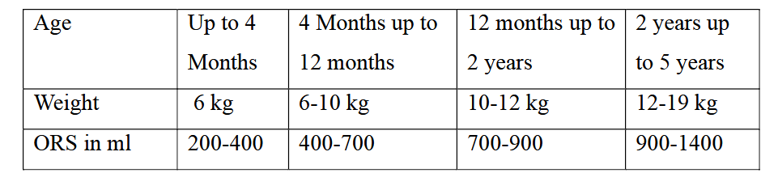
Amount of ORS to be given during the first 4 hours depending on the age of the child.

Slide 43
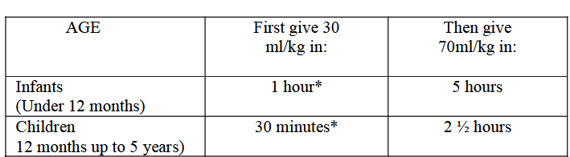
Severe ԁеhуԁrаtiоn (Plan C)
Requires treatment with IV fluids (RL or NS).
Repeat once if radial pulse is still very weak or not detectable.
Reassess the child every 1-2 hours. If hydration status is not improving, give the IV drip more rapidly.
Also give ORS (about 5 ml/kg/hour) as soon as the child can drink: usually after 3-4 hours (infants) or 1-2 hours (children).
Reassess an infant after 6 hours and a child after 3 hours and classify dehydration.

Slide 44
Suspect cholera in children > 2 years old who have acute watery diarrhoea and signs of severe dehydration or shock, if cholera is present in the area.
Give an oral antibiotic to which strains of V. cholerae in the area are known to be sensitive.
Possible choices are: erythromycin, ciprofloxacin and co-trimoxazole.
Prescribe zinc supplementation as soon as vomiting stops.

Slide 45
Pharmacologic
Vitamin A,
50,000 IU for age < 6 months,
100,000 IU for age 6 – 12 months,
200,000 IU for those > 12 months.
ADRs: diarrhoea, vomiting, irritability, drowsiness.
C/Is: renal impairment.
D/Is: cholestyramine or colestipol reduces its absorption.

Slide 46
Zinc supplementation
Age ≤ 6 months: half tablet (10 mg) per day for 10–14 days.
Age ≥ 6 months: one tablet (20 mg) per day for 10–14 days.
It helps the child’s recovery, reduces the duration and severity of the episode, and lowers the incidence of diarrhoea in the following 2–3 months.

Slide 47
Management of impetigo
Non pharmacologic
Careful removal of crusts by bathing with Normal saline or Hydrogen peroxide ensures more rapid healing.
Pharmacologic
Topical: for localized
First line
Mupirocin, applied thin film of 2% cream/ointment 2-3 times a day for 10 days.
ADRs: irritaion.
Alternatives
Fucidic acid, applied thin film of 2% cream 2-3 times in a day for 10 days.
ADRs: irritation.
N.B. Anti-bacterial ointments are usually applied after the wet lesion has dried.

Slide 48
Systemic: for extensive
First line
Cloxacillin.
Alternative
Cephalexin, 250mg to 500mg P.O., QID for 7 to 10 days for adults; 25 to 100mg/kg P.O. in 4 divided doses for 7 to 10 days for children.
OR
Erythromycin.

Slide 49
Management of cellulitis
Pharmacologic
First line
Procaine penicillin,
Children; 50,000u/kg/24 hrs. in a single dose for 10 days.
If penicillinase resistant staphylococcus suspected:
Semi-synthetic penicillins (e.g. Cloxacillin 0.5 – 1gm every 4 hrs.) should be administered intravenously until the fever subsides, (usually 2 – 3 days). Then Cloxacillin 500 mg. P.O QID should be continued for 7 days.
Hospitalized patients should be treated with Crystalline Penicillin 1.2-2.4 million units IV 4 hourly.

Slide 50
Alternative
Erythromycin.
N.B. In all children with facial or periorbital cellulitis, coverage for Haemophilus should be provided with Chloramphenicol 30 to 50mg/kg/d divided in two four doses
OR
Cephalexin, 500 mg P.O., QID.

Slide 51
Management of scabies
Non pharmacologic
washing clothes in hot water or ironing clothes after normal washing.
Pharmacologic
Permethrin 5% cream(first line) : applied to all areas of body from the neck down for 8-14 hrs then wash off. Repeat the same dose after a week.
Benzyl benzoate – applied to the entire body, neck to toe for 3 to 5 consecutive evenings. Bath should be taken before the first and after the last application.
ADE: Irritation of skin.

Slide 52
Sulfur ointment- children 5%, thinly applied to the entire body for 3 consecutive nights.
The patient should wash thoroughly before each new application and 24 hour after the last treatment.
ADE: skin irritation
Contraindications: pregnancy or lactation, children younger than 2 years.

Slide 53
Systemic
Ivermectin (200 µg/kg) – as a single dose, for crusted scabies and resistant forms of scabies and it is ideal for institutional outbreaks.
Prevention
Treat all households and close contacts simultaneously.
Wash clothing, bedding, and towels used with in the previous 3 days in hot water (50oc) and seal them in plastic bag for at least 72 hours.
Avoid close skin to skin contact until treatment is completed.

Slide 54
Prescription writing

Slide 55
Introduction
Prescription is a written physician order choosing an appropriate medication or a device for a patient, in a given clinical situations.
The prescription is the link between the prescriber, the pharmacist (or dispenser) and the patient so it is important for the successful management of the presenting medical condition

Slide 56
Content of a prescription
A prescription should contain:
▪ Name, address, age ,body weight of the medicine consumer and Date of the prescription;
▪ Diagnosis; Generic name, dosage form and strength and directions for use of the medcines. The pharmaceutical form (for example ‘tablet’, ‘oral solution’, ‘eye ointment’) should also be stated.
prescriber’s name, signature and address.

Slide 57
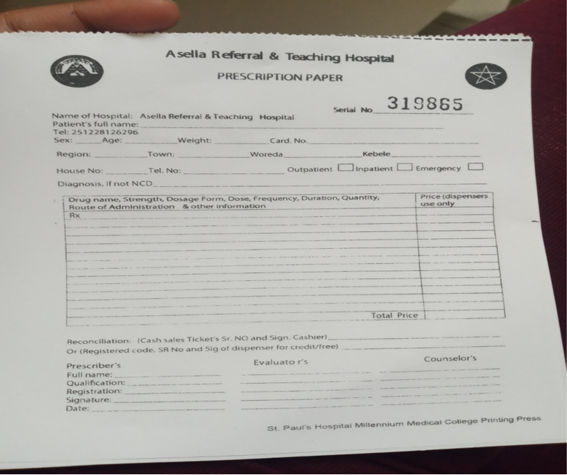

Slide 58
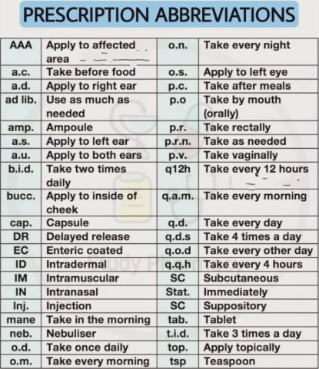

Slide 59
Abbrevations and Terms not to be used
Ambiguous decimal points can cause 10-fold overdose.
example:write 0.1 mg, not .1 mg.
write 1 mg, not 1.0 mg (avoid trailing zero).
Unsafe Abbreviations
Do not use U → write units.
Do not use μg/mcg → write microgram.
Do not use QD/Q.D. → write daily.
Do not use QOD → write every other day.
Do not use tsp/tbsp → write 5 mL/15 mL.

Slide 60
Incomplete Prescriptions
Always specify the exact dose (mg), not just dosage form.
Example: Avoid "1 ampule of furosemide" (multiple strengths available).
Write full drug names; avoid abbreviations (e.g., ASA, 6MP).
Use generic names whenever possible.
Mention the indication on the prescription (e.g., "for glaucoma").

Slide 61
Example:- This is Naol Temesgen a 2 years old male child that developed a runny nose 5 days ago, followed by a cough and fever. Over the last 24 hours, his mother noticed rapid breathing, reduced appetite, and decreased activity. There is no history of choking or foreign body aspiration. Immunizations are up to date.
Physical Examination:
Weight: 10 kg Respiratory rate: 42 breaths/min
Oxygen saturation: 94% on room air Temperature: 38.3°C Heart rate: 120 beats/min Mild chest indrawing Crackles over the right lower lung field Bronchial breath sounds in the right lower lobe
Investigations:
Chest X-ray: Right lower lobe consolidation
CBC: Elevated white blood cell count with neutrophil predominance
Diagnosis: Community-acquired pneumonia (mild to moderate, suitable for outpatient management).

Slide 62
Amoxicillin oral suspension
Dose:30- 50 mg/kg/day TID for 5-7 days (total daily dose 150 mg/kg/day)
For a 10 kg child: 500mg per dose, three times daily.
If using a 250 mg/5 mL suspension, this is approximately 3.3~3mL PO every 8 hours for 5 days.
Paracetamol oral suspension (160 mg/5 mL)
Dose: 15 mg/kg/dose every 4–6 hours as needed for fever.
For a 10 kg child: 150 mg (4.5mL) po PRN(as needed).
Maximum: 4 doses in 24 hour

Slide 63
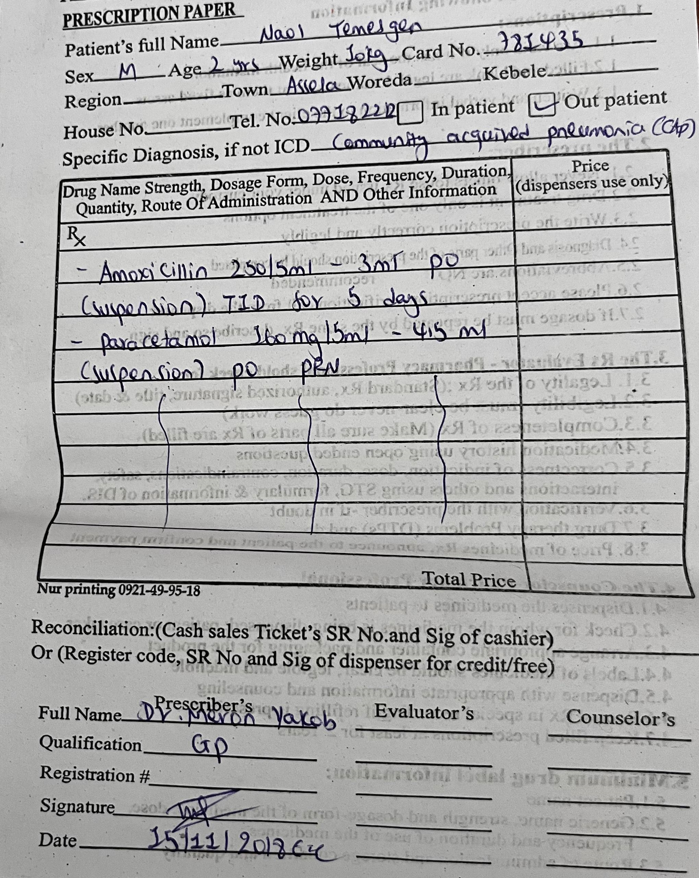

Slide 64
Steps of rational prescribing
Step 1: Define the patient's problem
Step 2: Specify the therapeutic objective
Step 3: Verify the suitability of a drug
Step 4: Write a prescription
Step 5: Give information, instructions and warnings
Step 6: Monitor (and stop) the treatment

Slide 65
Which patients are most at risk of prescription error?
patients on multiple medications
patients with another condition, e.g. renal impairment, pregnancy
patients who cannot communicate well
patients who have more than one doctor (medicine reconciliation)
patients who do not take an active role in their own medication use
children and babies (dose calculations required)

Slide 66
What you can do to make medication use safer
Know the medication you prescribe well
Use memory aids
Develop checking habits

Slide 67
References
Nelson Textbook of Pediatrics. 22nd ed.
WHO. Pocket Book of Hospital Care for Children: Guidelines for the Management of Common Childhood Illnesses. 2nd ed. Geneva: WHO; 2013
Federal Ministry of Health, Ethiopia. Standard Treatment Guidelines for General Hospitals. 4th ed.
Basic & Clinical Pharmacology Twelfth Edition.
WHO Prescription writing guidelines

